Slide 1
Diagnosing Autism in Demographics
Springboard Capstone Project by Patrick Shan

Slide 2
Background
The number of autism spectrum disorder (ASD) cases are rising around the world
There is interest in understanding the demographics of ASD
Questions
Which demographics are most likely to be diagnosed?
Which demographics are most likely to show ASD symptoms?
Does ethnicity affect ASD diagnosis or symptoms?
Does gender affect ASD diagnosis or symptoms?
How can ASD demographics patterns affect research and treatment?

Slide 3
Clients
Social Workers
Identify demographics most likely to have ASD
Properly allocate their resources for demographics of most need
Autism Researchers
Identify demographics for more further research
Anthropologists and Sociologist
Understand the differences and genders

Slide 4
Data Set Background
Source: Department of Digital Technology Manukau Institute of Technology
Type: Classification
Website: Kaggle.com
Link: https://www.kaggle.com/faizunnabi/autism-screening

Slide 5
Data Wrangling
Dataset converted to pandas dataframe in Jupyter Notebooks using Python coding language
Categorical entries were standardized with consistent spelling and punctuation
Two smaller dataframes were created focusing only on gender and ethnicity, respectively
Smaller ethnic groups with counts less than 20 were removed as outliers

Slide 6
Variables
Independent Variables
Ethnicities:
Asian
Black
Hispanic/Latino
Middle Eastern
Not Available
Other
South Asian
White-European
Gender:
Male
Female
Dependent Variables
Score (ASD Symptoms)
ASD (Diagnosis Status)

Slide 7
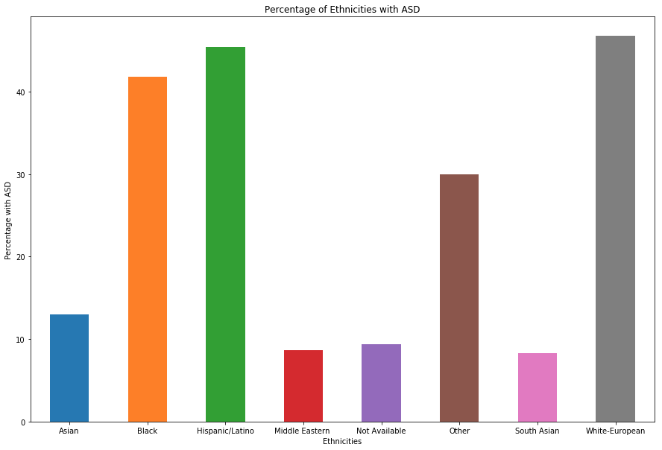
ASD Diagnosis Rates by Ethnicity
Ethnicities with highest rates
Black
Hispanic/Latino
White European
Ethnicities with lowest rates
Middle Eastern
Not Available
South Asian

Slide 8
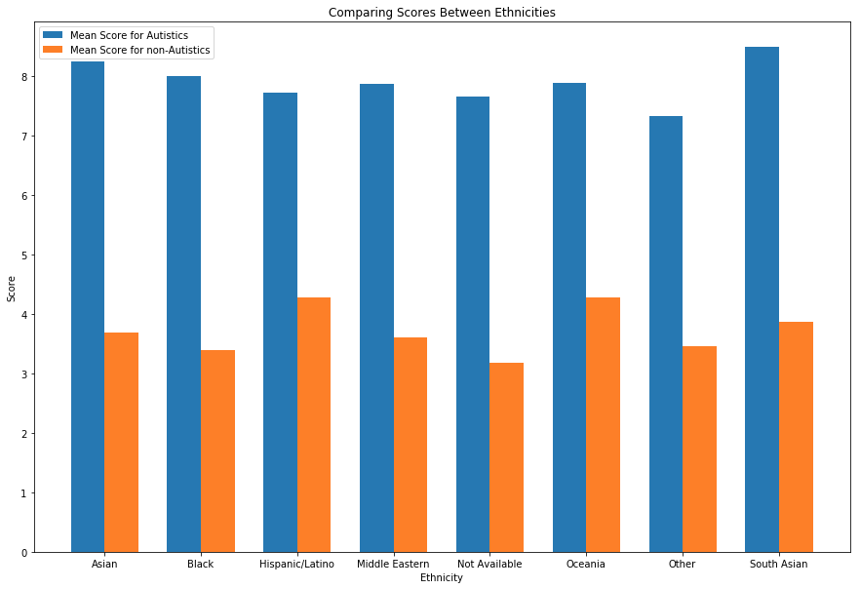
ASD Scores by Ethnicity
ASD individuals have higher questionnaire scores than non-ASD individuals
Non-ASD individuals have scores between 3 and 5
ASD individuals have scores between 7 and 8
Ethnicities with lowest rates
Middle Eastern
Not Available
South Asian

Slide 9
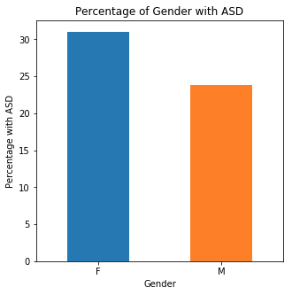
ASD Diagnosis Rates by Gender
Female have higher rates of ASD diagnosis than males
Both genders have rates above 20%

Slide 10
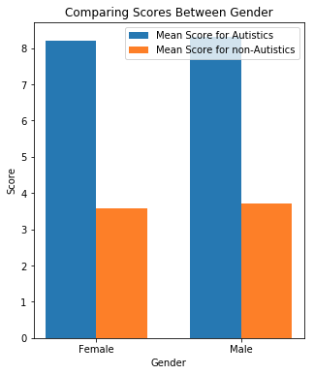
ASD Scores by Gender
As seen with ethnicity comparison, ASD individuals have highers scores than non-ASD individuals
In contrast to ASD rates, there isn't any difference between genders

Slide 11
Inferential Statistics
Performed two-sample z-test to compare samples to mean values
Sample variance can be deduced
Sample size of data is greater than 30 samples
If p-value in a value comparison is less than 0.05, then any differences in values are statistically significant

Slide 12
Two Sample Z-Test for Ethnicity
Ethnicity | P-Value for Ethnicity Proportion | P-Value for Ethnicity Score
Asian | 0.001 | 0.996
Black | 0.039 | 0.286
Hispanic/Latino | 0.023 | 0.019
Middle Eastern | 1E-4 | 0.251
Not Available | 1E-4 | 0.009
Other | 0.741 | 0.214
South Asian | 0.012 | 0.001
White-European | 3.595E-8 | 0.017

Slide 13
Two Sample Z-Test for Gender
P-Value for Gender Proportion | P-Value for Gender Score
0.035 | 0.519

Slide 14
Machine Learning Regression
Comparing ASD Scores (Regression)
Linear Regression
Model fits demographic features and scores to linear trend
Benefit of quick performance
Random Forest Regression
Model creates aggregated branched outcomes based on features (represented as nodes)
Determines importance of demographic features on scoring

Slide 15
Machine Learning Classification
Comparing Likelihood of Diagnosis (Classification)
Naive Bayes (NB)
Model is based on Bayes Theorem
Determine likelihood of event happening given criteria
Multinomial NB for ethnicity
Binomial NB for gender
Random Forest Classification
Model creates aggregated branched outcomes based on features (represented as nodes)
Determines importance of demographic features on ASD diagnosis

Slide 16
Linear Regression for Scoring
Positive Correlation
Asian, Other, White-European, Male, Autistic
Negative Correlation
Black, Hispanic/Latino, Middle Eastern, Not Available, South Asian, Female, Non-Autistic
R^2 Value: 0.700
Root Mean Squared Error: 1.36

Slide 17
Multinomial Naive Bayes For Ethnicity
Ethnicity | Percentage of Autistics Comprised of Ethnic Group | Percentage of Ethnic Group with Autism
Asian | 18.61 | 28.29
Black | 8.14 | 35.40
Hispanic/Latino | 6.98 | 39.54
Middle Eastern | 9.30 | 18.91
Not Available | 13.95 | 27.18
Other | 4.65 | 28.99
South Asian | 4.65 | 24.16
White-European | 33.72 | 27.06

Slide 18
Binomial Naive Bayes For Gender
Gender | Percentage of Autistic Comprised of Gender | Percentage of Gender Diagnosed with Autism
Female | 50.581 | 28.750
Male | 49.419 | 25.886

Slide 19
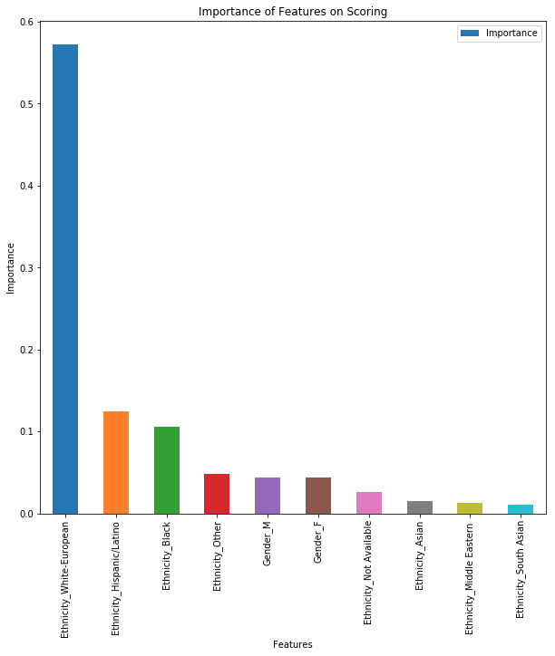
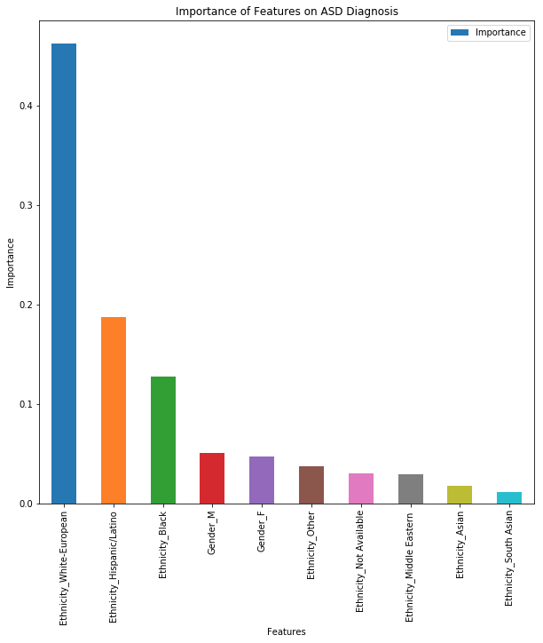
Random Forest

Slide 20
Project Summary
Visualization
Questionnaire scores are higher for those diagnosed with ASD
Black, Hispanic/Latino, and White/European have highest diagnosis rates. However, mean scores appear consistent among ethnicities
Females have higher diagnosis rates than men yet no apparent difference between gender in mean scores
Inferential Statistics
Except for "Other", diagnosis rates are significantly different between ethnicities.
Hispanic/Latino, South Asian, and White European have scores that are significantly different from mean score
Gender proportions are significant but scores aren’t

Slide 21
Project Summary (cont.)
Naive Bayes
While White-Europeans are most represented in autism population, all ethnicities have rates of diagnosis from 21-37% range
Female are more likely to have higher autism rates and higher representation in population
Random Forest Regression for ASD Scoring
White-European ethnicity is demographic feature with the most importance
Hispanic/Latino and Black ethnicities are the next most important features
Gender for men and women are 5th and 6th most important features
Random Forest Classification for ASD Diagnosis
White-European ethnicity is demographic feature with the most importance
Hispanic/Latino and Black ethnicities are the next most important features despite smaller representation size
Gender for men and women are 4th and 5th most important features

Slide 22
Conclusion
EDA suggests that White-European ethnicity have the greatest impact on ASD scoring and diagnosis rates
However, machine learning suggests that the differences between ethnicities in representation aren't quite as pronounced
Data may suffered from overrepresentation of White-Europeans and Asians
Ethnicity may play greater role than gender in autism diagnosis rates and scoring
Genders have different diagnosis rates but no difference in scoring

Slide 23
Limitations
Uneven ethnicity representation
White-Europeans are largest sample size
Smaller ethnicities can skew data and lead to outliers
Uneven gender representation
Male and female genders are not equal in size
Problems with questionnaire format
Some categorical string values are inconsistent in spelling and format
Nationality has too many distinct countries

Slide 24
Future Directions and improvement
Futures tests on demographics
For gender comparison, make sure gender populations are equal
For ethnicity, make sure ethnic populations are equal
Ethnicity should be answered using multiple choice format to maintain consistent answers
Geographical attribute could be changed from nationality to region for simplicity since there are too many unique nations
The number of unique ethnicities could be reduced to avoid outliers

Slide 25
Recommendation
Conduct future studies on and direct resources towards Black and Hispanic/Latino populations given their importance in ASD diagnosis and scoring relative to sample size
Future studies can focus on comparing ASD diagnosis rates for single attribute (i.e. comparing rates between only ethnicities)
Based on this data, more resources and attention related to ASD treatment should go to Black, Hispanic/Latino, and White ethnicities

